Slide 1
Balance Sheet KPI and Metrics

Slide 2
References:
ZURICH AUSTRALIAN INSURANCE LIMITED Balance Sheet 31st December 2021
https://www.zurich.com.au/content/dam/au-documents/web/zail-annual-report-results-2021.pdf
ZURICH INSURANCE GROUP Annual report 2021
https://www.zurich.com/reports/2021/annual-report/

Slide 3
Ratios:
Debt equity ratio = Debt/Equity. shows how much your financial position is leveraged. The more its value, the more financial distress.
Debt ratio - shows what share of your assets is financed by debt, and provides a measure of financial risk you’re taking. Normally, shouldn’t be more than 0.7 because a higher ratio suggests higher risk.
Working capital - shows how much of your current assets are financed by long-term, rather short-term, sources. Higher working capital indicates your ability to finance your current operations without relying on short-term borrowings.
Current Ratio - shows your ability to cover your current liabilities so it should be more than 1. Otherwise, it would be a sign of trouble if you run into financial difficulty.
Investment to Asset Ratio - Net income/ Total assets. To evaluate the proportion of a company's assets that are actively generating income.

Slide 4
Metrics:
Composition of equity- What makes up tota equity eg. Contributed equity, Reserves, Retained profits
Composition of Assets - What makes up total assets eg. Cash and Cash equivalents, Receivables, Reinsurance and Other recoveries, other assets etc.
Composition of liabilities - What makes up total liabilities eg. Payables, provisions, unearned premium etc.
Premiums receivable - future premiums to be received
Reinsurance recoverable - money that the reinsurers owe
Prepaid reinsurance premium - money already paid to reinsurers for future reinsurance policies ()
Deferred acquisition cost money already paid -- but not expensed yet -- such as agent commissions and premium taxes, to acquire policies ().
Assets - Investments
Net Assets = Total Assets-Total Liabilities

Slide 5
Zurich Balance Sheet Extracts

Slide 6
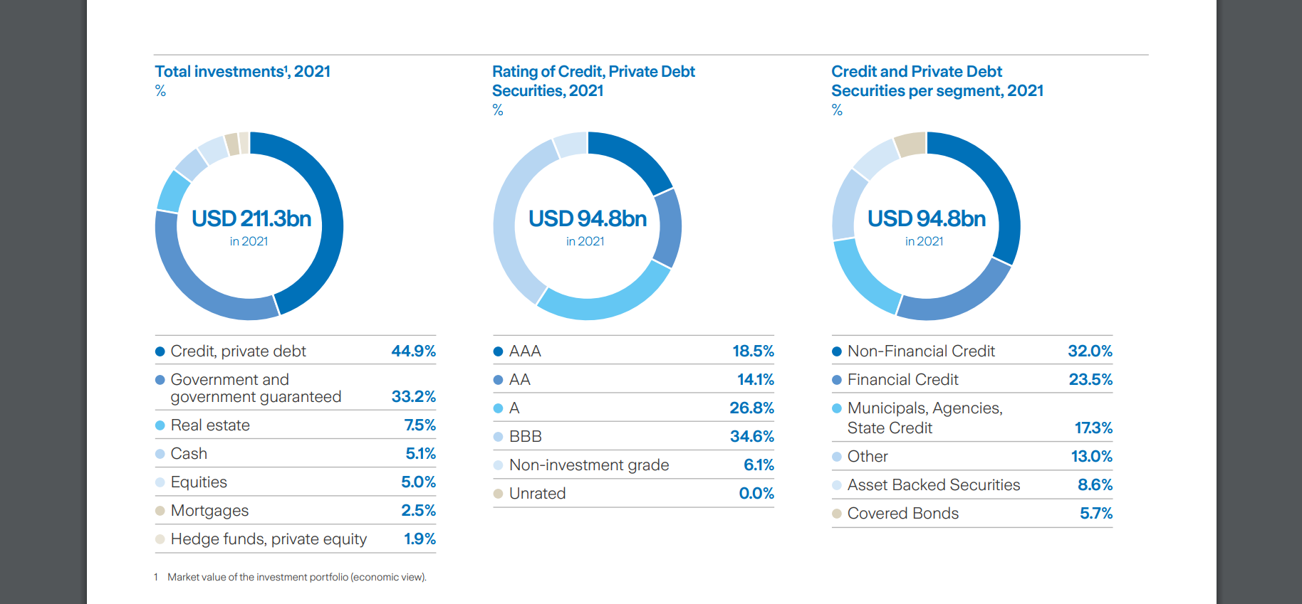

Slide 7
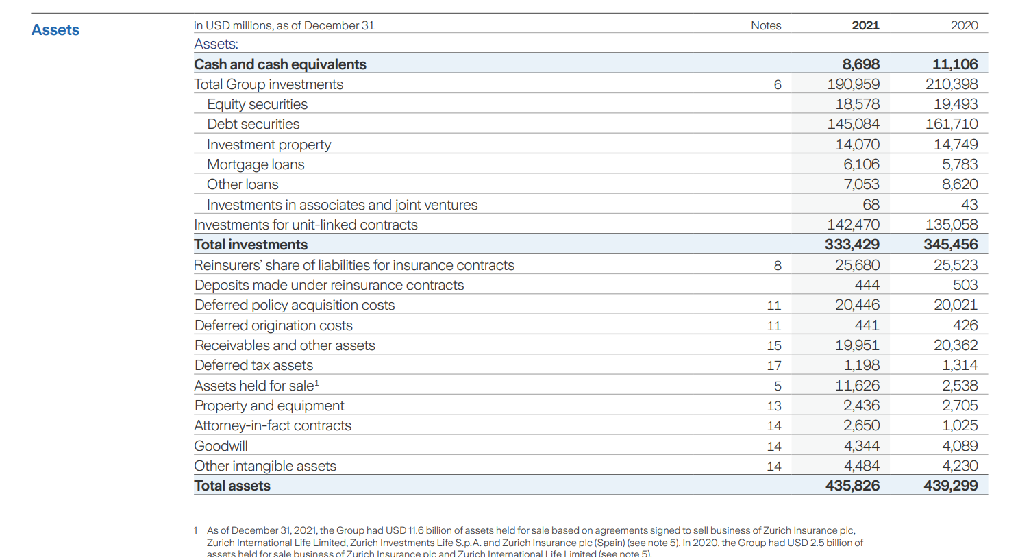
Composition of Assets

Slide 8
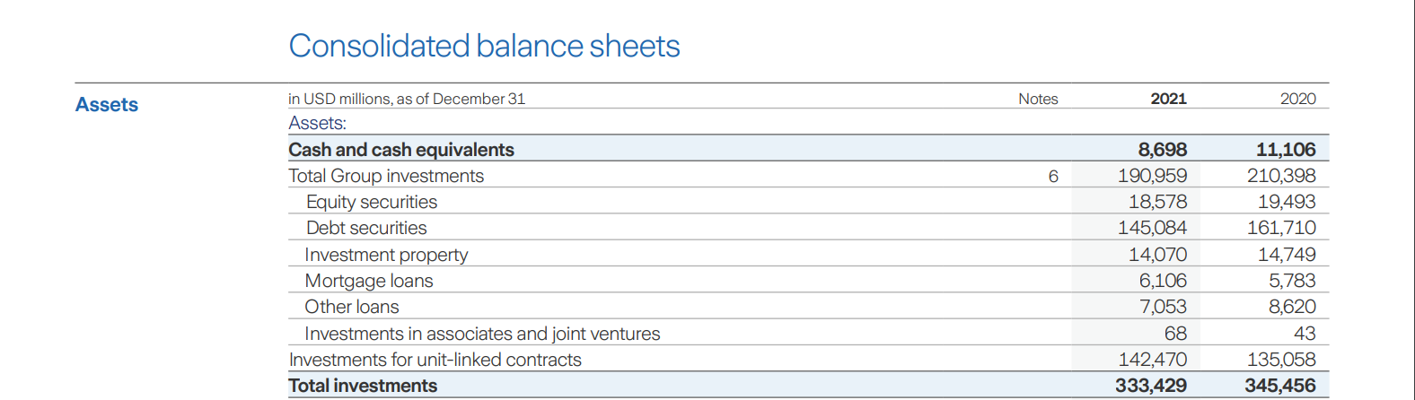
Composition of Investments

Slide 9
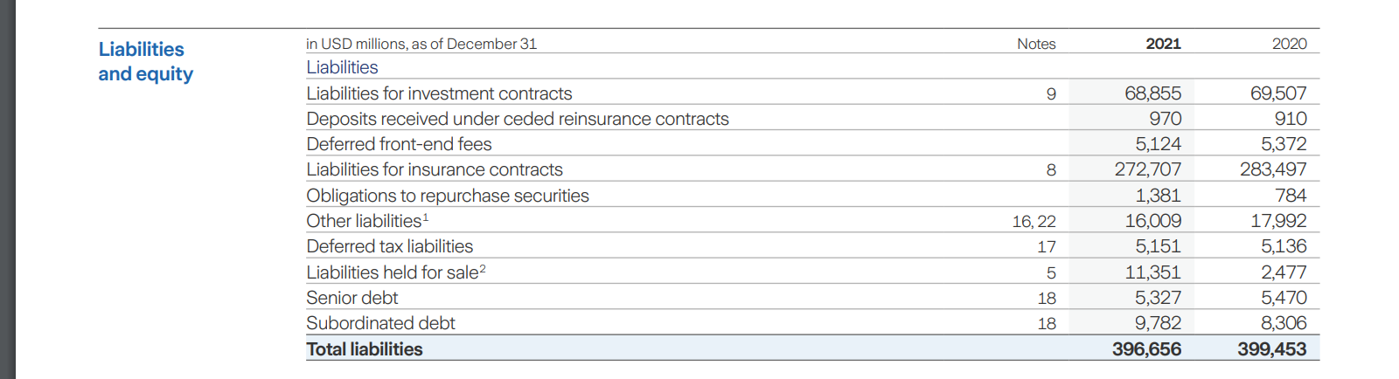

Debt equity ratio = Debt/Equity

Slide 10
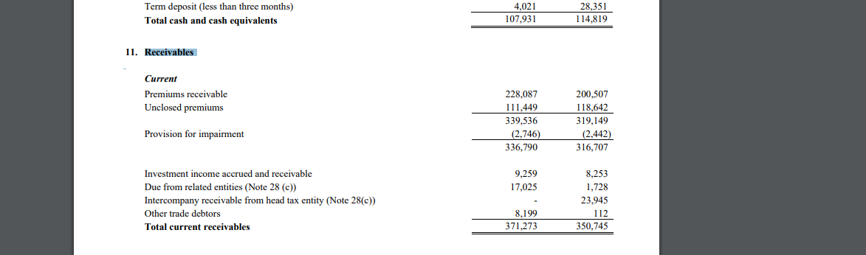
Premium Receivables-Sample
Australia: Starts at pg 7 and notes can be valuable
https://www.zurich.com.au/content/dam/au-documents/web/zail-annual-report-results-2021.pdf

Slide 11
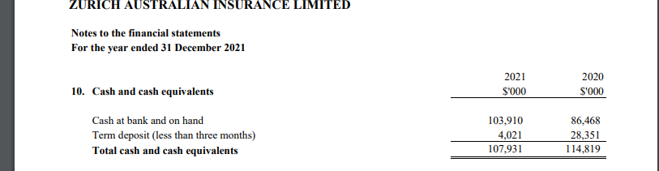
Change in cash position

Slide 12
Mockups

Slide 13














Composition of Assets, Liabilities and Equity

Slide 14








Composition of Assets, Liabilities and Equity
Debt equity ratio
Debt ratio
Working capital
Current Ratio
Investment to Asset Ratio
Notes:
Debt equity ratio = Debt/Equity. shows how much your financial position is leveraged. The more its value, the more financial distress.
Debt ratio - shows what share of your assets is financed by debt, and provides a measure of financial risk you’re taking. Normally, shouldn’t be more than 0.7 because a higher ratio suggests higher risk.
Working capital - shows how much of your current assets are financed by long-term, rather short-term, sources. Higher working capital indicates your ability to finance your current operations without relying on short-term borrowings.
Current Ratio - shows your ability to cover your current liabilities so it should be more than 1. Otherwise, it would be a sign of trouble if you run into financial difficulty.
Investment to Asset Ratio

Slide 17
Appendix

Slide 18
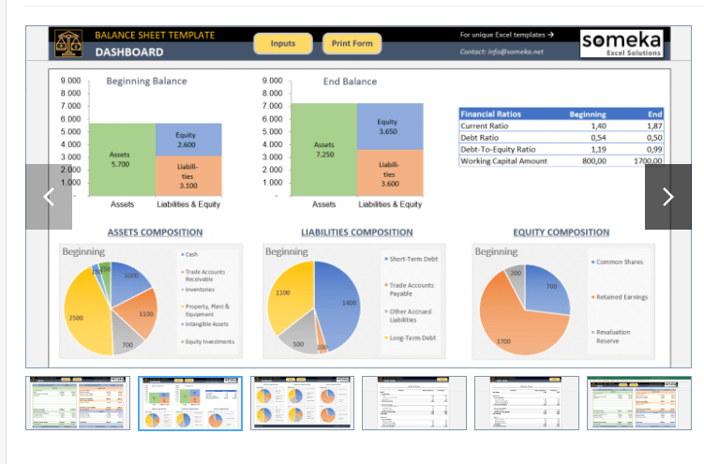

Slide 19
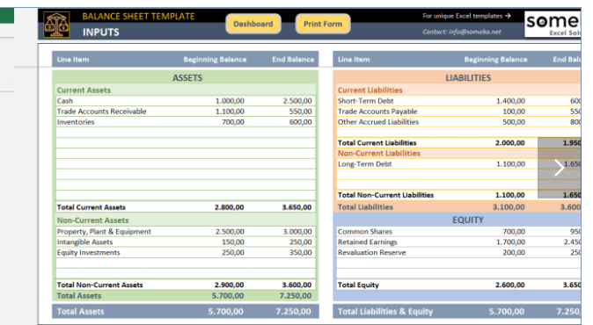

Slide 20
